Slide 1

Data Exploration and Preparation
Diploma in DAB – L7
CCT College Dublin
Introduction to Data Exploration
Week 1
Lecturer: Dr. Muhammad Iqbal*
Email: miqbal@cct.ie

Slide 2

Outline
Introduction to Data
Variables, observations and attributes in Data Analytics
Data types
Primary and Secondary data
Steps involved in data acquisition and management
Version control system
Digital tools

Slide 3
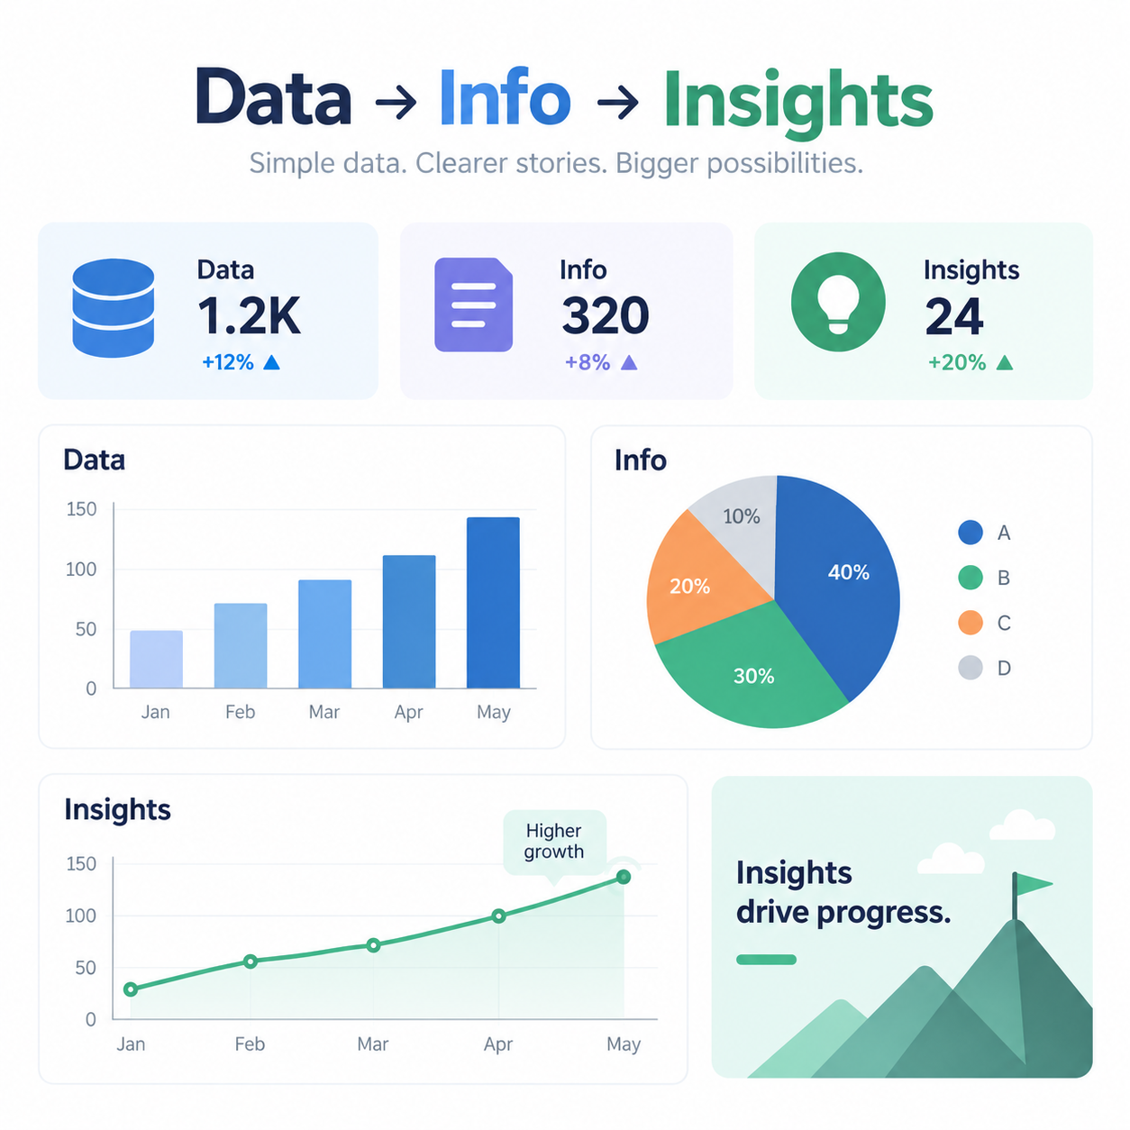
Introduction to Data
Data consists of recorded facts, measurements, observations or events that can be stored, processed and analysed.
Examples: Age, Price, Number of purchases, Transaction dates, Images, Social-media posts and Sensor readings
Data vs Information
Data: Raw observations or recorded values.
Information: Data that has been organised, processed or interpreted to provide meaning.
Data: €120, €95, €180, €210, €140 and
Information: Average customer transaction = €149
Notes:
Business Perspective
Organisations use data to
Understand customers
Monitor performance
Identify trends
Predict future outcomes
Support decision-making

Slide 4
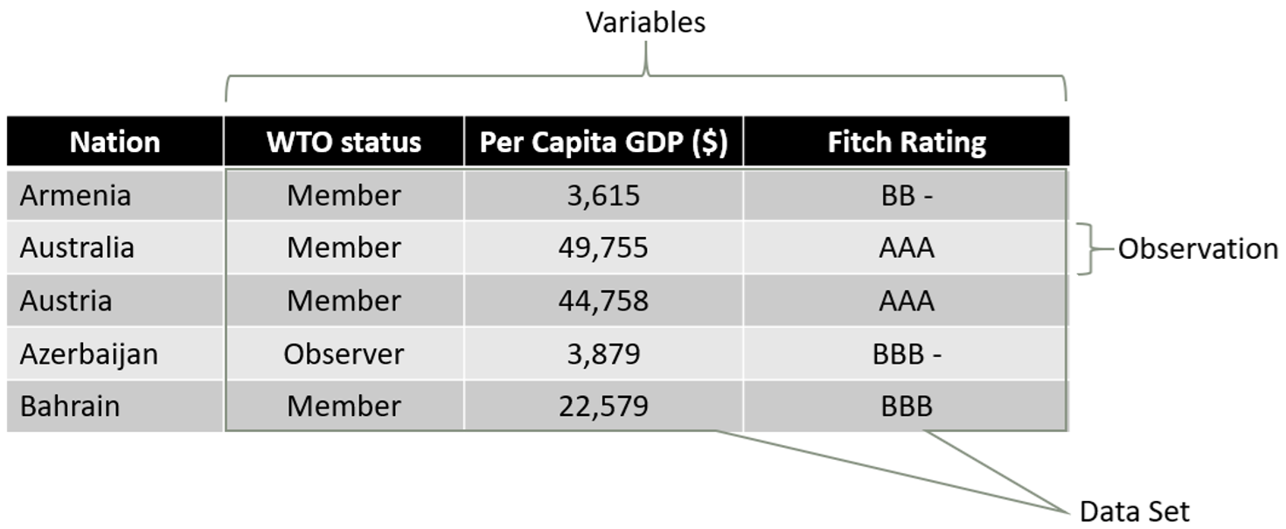
Understanding a Dataset
Observation: An observation represents one individual entity or instance. For example: One row = one customer observation
Variable: A variable represents something that can take different values. For example: Age, Region, Number of purchases and Spend
Attribute: An attribute is a characteristic or property describing an entity. For example, Age and Region are attributes of a customer.
Customer ID | Age | Region | Purchases | Spend
C001 | 24 | Dublin | 5 | €320
C002 | 31 | Cork | 3 | €190
C003 | 42 | Galway | 8 | €640

Slide 5
Types of Data
Understanding the type of data is important because it determines which analytical techniques can be applied.
Categorical Data: Represents groups or labels. For example, Department, Country, Customer type and Product category
Nominal: Categories without a natural order. For example: Dublin, Cork, Galway
Ordinal: Categories with a meaningful order. For example: Low → Medium → High
Numerical Data: Represents measurable quantities.
Discrete Data: Usually countable values. For example: Number of purchases = 6
Continuous Data: Can take values within a range. For example: Revenue = €1,245.75
Is Customer Satisfaction: Poor / Average / Good

Slide 6
Data Management
Data management concerns how data is
Collected → Stored → Organised → Maintained → Used → Shared → Archived
Good data management makes data easier to Locate, Understand, Analyse, Reproduce, Protect and Share appropriately.
Important Data Management Practices are
File organization: Consistent folder structures and Meaningful file names
Documentation: Data dictionaries, README files and Metadata
Data quality: Accuracy, Completeness, Consistency and Validity
Data provenance: Where did the data originate? When was it collected? How was it transformed?
Principle: Good analysis begins with well-managed and well-understood data.

Slide 7
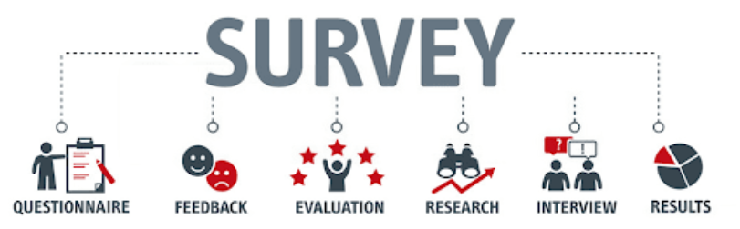
Primary and Secondary Data
Primary Data: Data collected directly for a particular research or business purpose. For example, Surveys, Interviews, Experiments, Customer questionnaires, Sensor measurements and Observation
Advantages: Specific to the research objective, greater control over collection and can provide current information
Challenges: Time consuming, Can be expensive and Requires careful design
Secondary Data: Data that has already been collected by another organization or for another purpose. For example, Government open-data portals, Central Statistics Office datasets, Company databases, Published reports, Public datasets and Research repositories
Advantages: Usually quicker to obtain, Often inexpensive and Can contain large datasets
Challenges: Quality may be unknown, Data may be outdated and Definitions may differ from your requirements
Notes:
Image source: https://www.formpl.us/blog/primary-research

Slide 8
What, Where and How of Data Acquisition
Before acquiring data, an analyst should ask three questions.
WHAT data do we need?
Start with the business question. For example: What factors influence customer churn?
Possible required variables: Customer age, Contract type, Monthly charges, Customer service interactions, Length of relationship and Churn status
WHERE can we obtain the data?
Possible sources include: Internal company databases, CSV/Excel files, APIs, Government open-data portals, Surveys, Public datasets, Sensors and Web-based sources
HOW will we acquire it?
Possible methods: File download, Database query, API request, Survey, Data collection system and Approved web-data collection
Before collecting data, consider: Privacy + Ethics + Licensing + Bias + Quality + Security

Slide 9
Version Control
Git and GitHub
Push: Send local commits to GitHub.
Pull: Retrieve changes from a remote repository.
Branch: A separate development path used to work on changes safely.
Why use GitHub in Data Analytics?
Tracks project development
Provides evidence of work
Supports collaboration
Protects against accidental loss
Improves reproducibility
Builds professional practice
Assignment Practice
Why Version Control?
During an analytics project, datasets, Python files and notebooks change repeatedly.
Without version control, files can become: analysis_final.py, analysis_final2.py, analysis_final_revised.py and analysis_really_final.py
Git provides a systematic approach.
Important Git Concepts
Repository: Folder containing the project and its version history.
Commit: A recorded snapshot of project changes.

Slide 10
Resources/ References
Ball, R. and Rague, B. The Beginner's Guide to Data Science, Springer Nature: The Beginner's Guide to Data Science – Springer DOI: 10.1007/978-3-031-07865-1. Springer lists the eBook/hardcover as 2022 and the softcover as 2023.
Foxwell, H.J. (2020), Creating Good Data: A Guide to Dataset Structure and Data Representation, Springer/Apress: Creating Good Data – Springer Nature/Apress. DOI: 10.1007/978-1-4842-6103-3.
McGregor, S.E., Practical Python Data Wrangling and Data Quality, O'Reilly Media: Practical Python Data Wrangling and Data Quality – O'Reilly. ISBN: 9781492091493. Note that O'Reilly's official page lists the publication date as December 2021, rather than 2022.
Narayana, D., Ranjan, S. and Tyagi, N. (2023), Basic Computational Techniques for Data Analysis: An Exploration in MS Excel, Routledge: Basic Computational Techniques for Data Analysis – Routledge
AI Publishing (2020), Data Preprocessing with Python for Absolute Beginners: Step-by-Step Guide with Hands-on Projects and Exercises, 2020 AI Publishing edition, ISBN 9781734790108: Data Preprocessing with Python for Absolute Beginners – Book listing
OpenAI. (2026). ChatGPT. OpenAI (CCT Licensed Version).
Some images are used from Google search repository (https://www.google.ie/search) to enhance the level of learning.
Copyright Notice
The following material has been communicated to you by or on behalf of CCT College Dublin in accordance with the Copyright and Related Rights Act 2000 (the Act).
The material may be subject to copyright under the Act and any further reproduction, communication or distribution of this material must be in accordance with the Act.
Do not remove this notice

